Slide 1

NBA Player Efficiency Rating As an Indicator of Salary

Slide 2
DATA
NBA Database containing collection of data from 1937 – 2011
https://relational.fit.cvut.cz/dataset/NBA
NBA Player Salaries from 1990 – 2018
https://data.world/datadavis/nba-salaries/workspace/file?filename=nba_salaries_1990_to_2018.csv
NBA Team Salary Cap History
http://www.celticshub.com/2017/12/07/nba-player-salaries-1991-2017/
NBA Player Stats Since 1950
https://www.kaggle.com/drgilermo/nba-players-stats#Seasons_Stats.csv

Slide 3
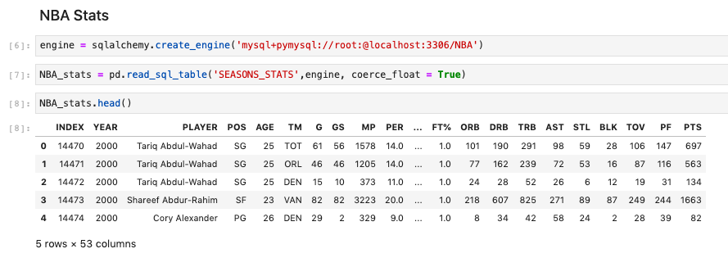
Access MySQL Through Python

Slide 4
Data Cleaning and Merging
Only data from the 2016-2017 season was used since it was the most recent common season
Each data needed to be cleaned in order that they all had matching columns to ease the merging
Data was checked for Null values and none were found
Data was merged and the final columns are as follows:
'Pos', 'Salary', 'Cap', 'CapShare', 'Age', 'PER', 'TS%', 'USG%', 'WS', 'BPM', 'eFG%', 'G', 'GS', 'MP', 'TRB', 'AST', 'STL', 'BLK', 'PTS'

Slide 5
Salary Cap Share
Each team is allotted a certain amount of spending money to obtain talent for their team.
The salary cap will be used to determine which players a team deems important.
The players own salary was be divided by the teams salary cap to produce a percentage of the total salary cap that the team was willing to spend on that player.
A player with a higher percentage can be regarded as more important in the eyes of the team.

Slide 6
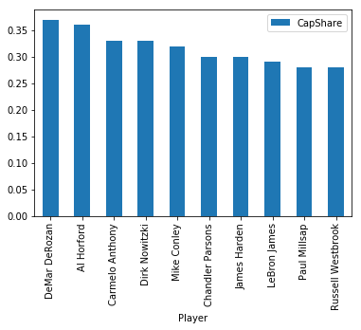
Which players do teams spend the most of their salary cap on?
DeMar Derozan has the highest salary cap share with Russell Westbrook having the 10th highest

Slide 7
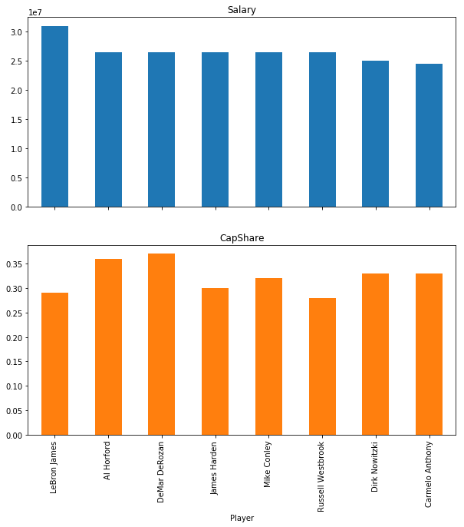
Where do the highest paid player for each team land in the rankings of the highest paid players of the league?
A player with a high cap share doesn’t mean they have a high salary
It appears that 8 out of the top cap share players are also top paid players

Slide 8
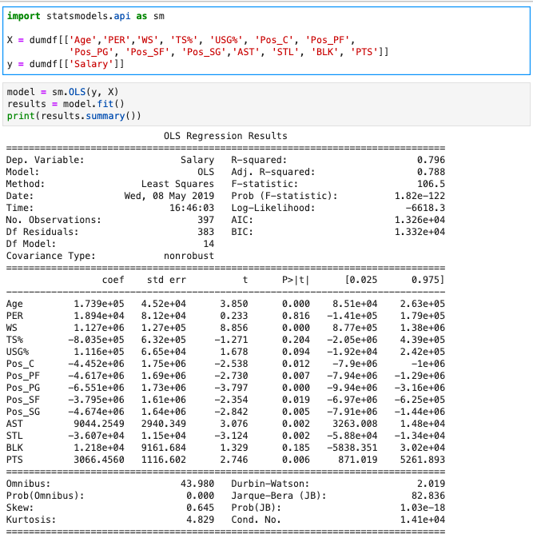
Linear Regression: Which measure and quality affect NBA salaries?
The high R – Squared value indicates that there is a high chance that these indicators can predict salaries
Almost all the p-values are less then 0.05 except for PER, TS% and BLK

Slide 9
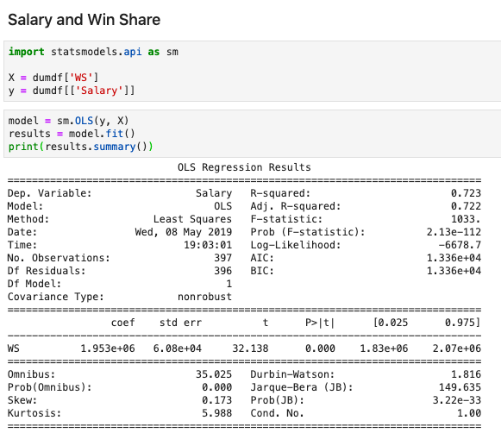
Win Share as an indicator of Salary
Win share is a measure which shows the contribution a player has on the teams wins
There is a strong possibility that Win share could indicate salary because of the R-squared value of 0.72 and a p-value bellow 0.05

Slide 10
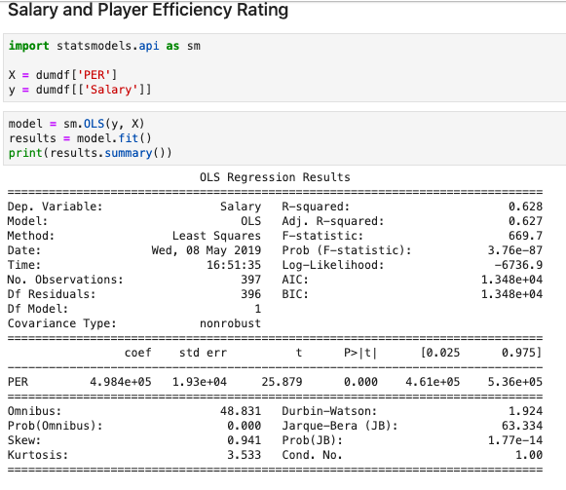
PER as an indicator of Salary
PER is not a good indicator for expected salary. The R^2 value is lower for PER (0.628) and salary then for WS and Salary

